Slide 1

Marketing & Retail Analytics Project Milestone 1
Athisya Nadar
Post Graduate Program in Data Science and Business Analytics
athisya@gmail.com

Slide 2
Agenda
Problem Statement
Executive Summary of the data
About Data
EDA
Customer Segmentation using RFM analysis
Inferences from RFM Analysis

Slide 3
PROBLEM STATEMENT
An automobile parts manufacturing company has collected data of transactions for 3 years. They do not have any in-house data science team, thus they have hired you as their consultant. Your job is to use your magical data science skills to provide them with suitable insights about their data and their customers.

Slide 4
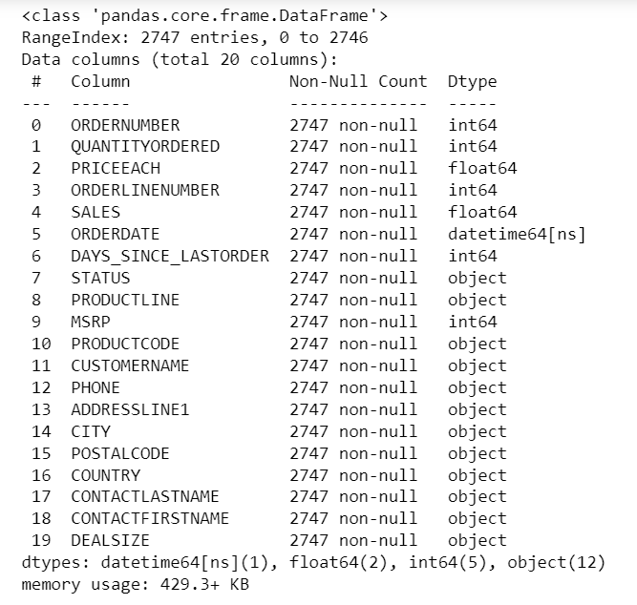
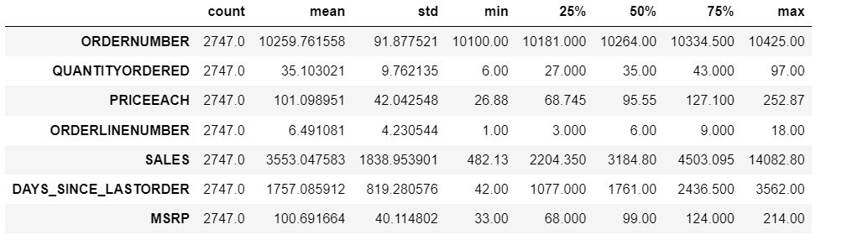
About data
The data consists of 20 columns and 2747 rows
There are no null values
There are no duplicate rows
We have 7 numeric columns, 1 date column, 7 categorical column

Slide 5
Executive SUMMARY
This project aims to find the underlying buying patterns of the customers of an automobile part manufacturer based on the past 3 years of the Company's transaction data and hence recommend customized marketing strategies for different segments of customers. After performing RFM analysis, we have come up with 4 segments which includes Champions, Loyal, At risk, Inactive. We have ranked them based on their recency, frequency and monetary values and binned the data on customer name level.

Slide 6
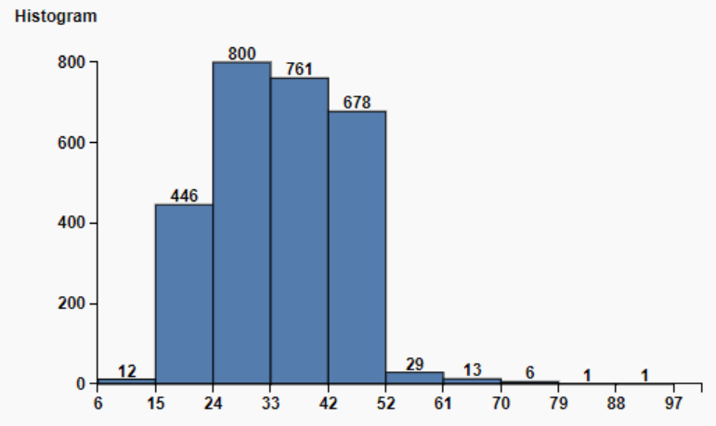
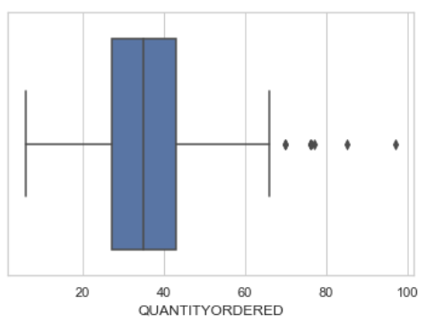
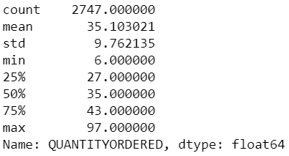
Quantity ordered
Quantity Ordered ranges from 6 to 97 with average of 35.10
Boxplot shows some outliers
Histogram shows skewness of 0.369 and kurtosis 0.443

Slide 7
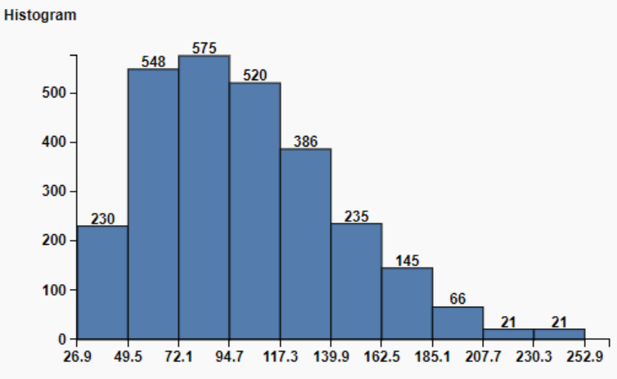
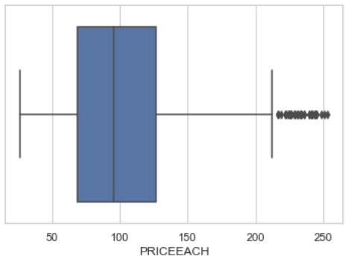
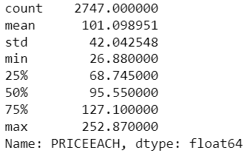
Price of each item
Price of Each item ranges from 26.88 to 252.87 with average being 101.09
Box plot shows lot of outliers
Histogram is skewed to the right with skewness of 0.697 and kurtosis of 0.229

Slide 8
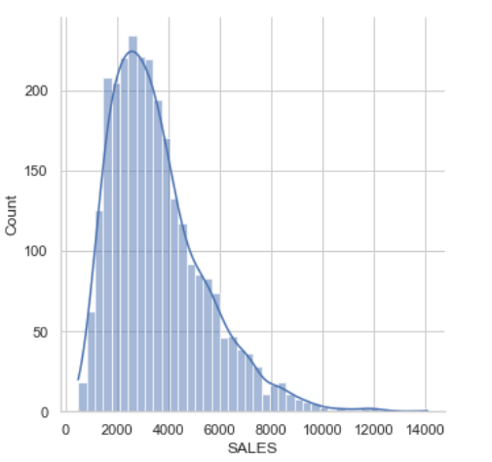
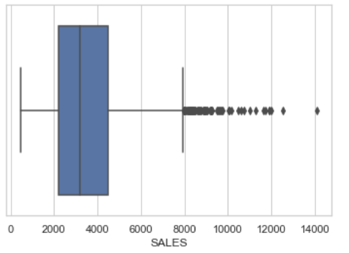
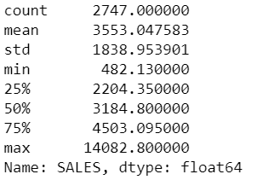
Sales
1.156
1.156
Sales values ranges from 482.13 to 14082.80 with average being 3553.04
Sales boxplot has outliers
Histogram is Right skewed with skewness of 1.156 and kurtosis of 1.773

Slide 9
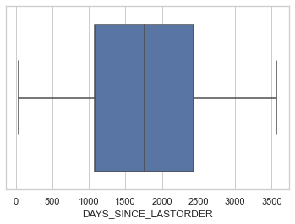
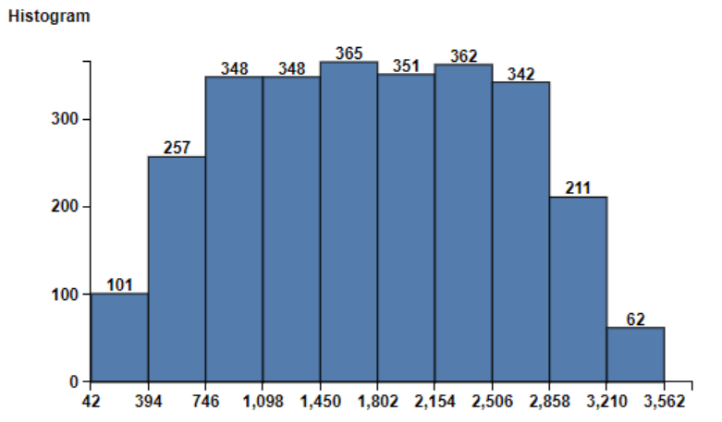
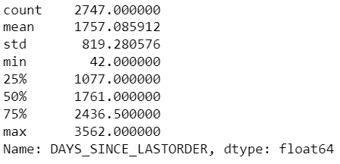
Days Since Lastorder
Number of days since last order ranges from 42 to 3562 with average being 1757.08
Box plot does not show any outliers
Histogram has skewness of -0.003 and kurtosis of -1.024

Slide 10
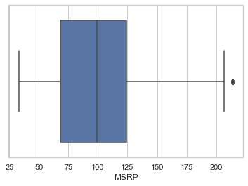
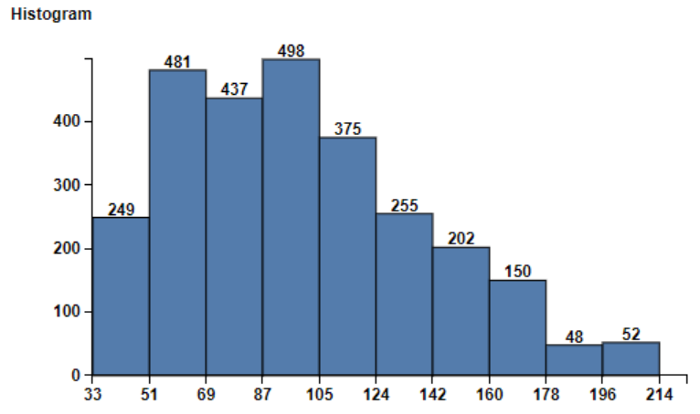
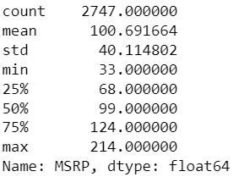
Manufacturer's Suggested Retail Price
MSRP ranges from 33 to 214 with average being 100.69
MSRP boxplot has outliers
Histogram has skewness of 0.576 and kurtosis of -0.139

Slide 11
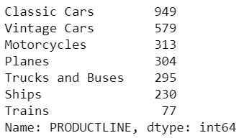
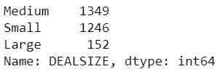
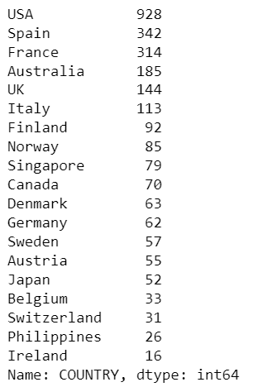
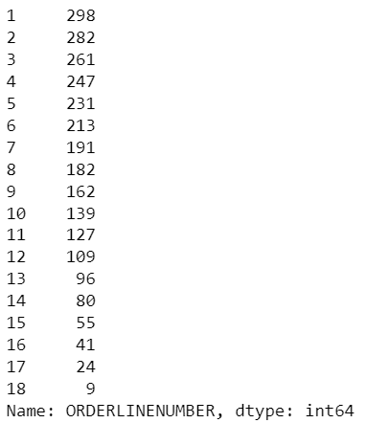
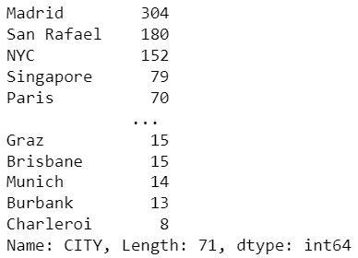
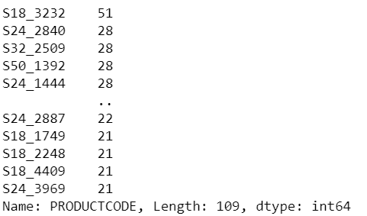
DealSIZE, city, country, order line number, product line, product code
Dealsize has small, medium and large categories
City column has 71 cities
Country column has 19 countries
Order Line number has 18 categories
Product Line has ships, trains, planes, Motorcycles, vintage cars, classic cars, trucks and buses
Product code has 109 categories

Slide 12
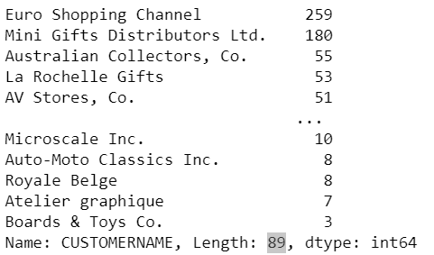
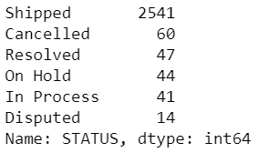
Customer Name, PHONE , ADDRESSLINE1 , POSTALCODE , CONTACTLASTNAME, CONTACTFIRSTNAME, ORDERNUMBER, STatus , ORDERDATE
There are 89 unique customer names
The status includes Shipped, Cancelled, Resolved, On Hold, In process, Disputed

Slide 13
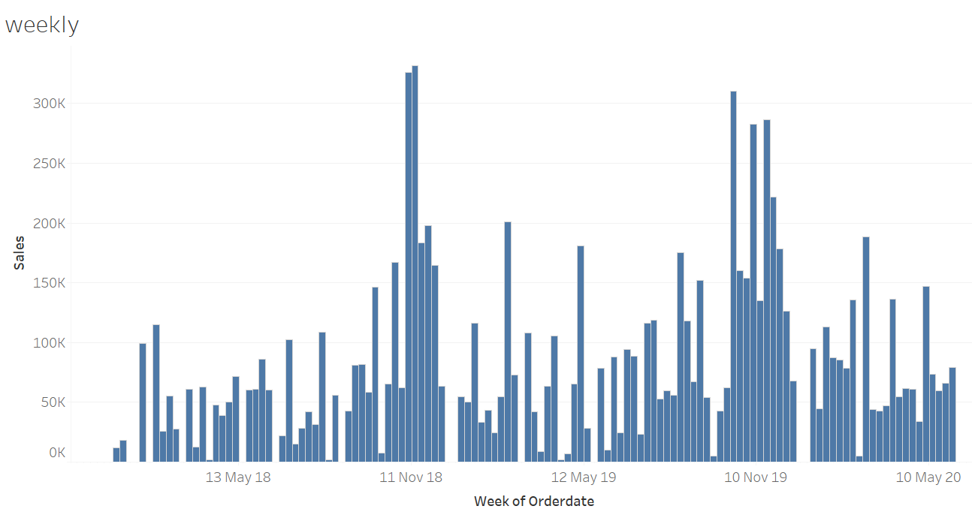
Weekly sales

Slide 14
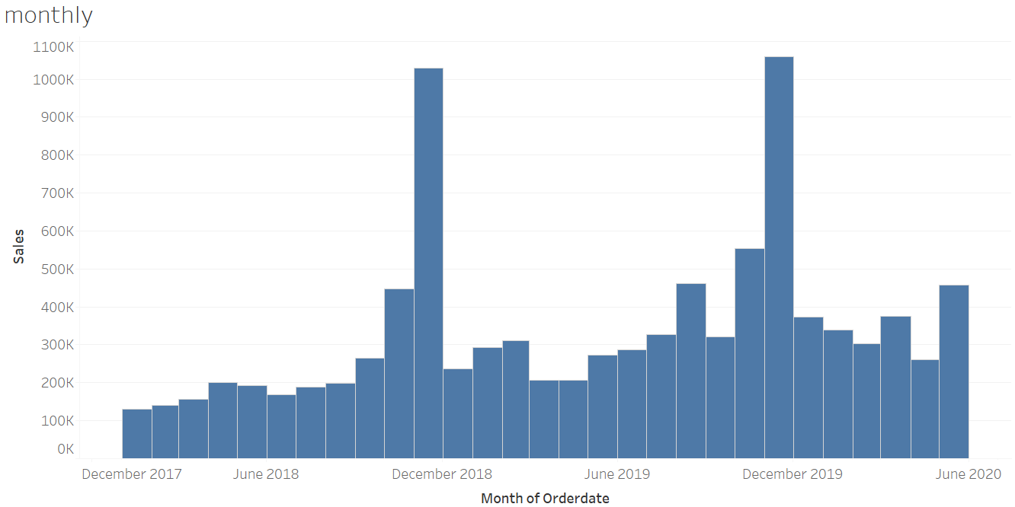
Monthly sales

Slide 15
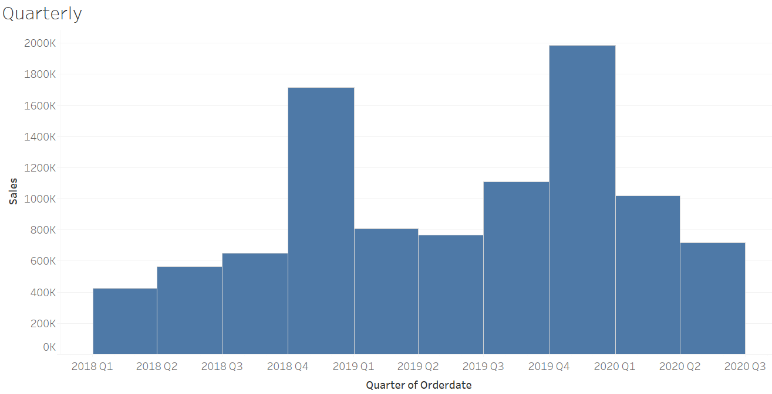
Quarterly sales

Slide 16
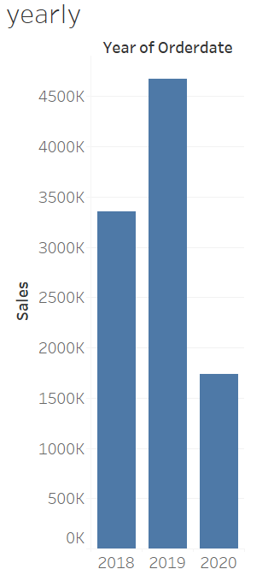
Yearly sales

Slide 17
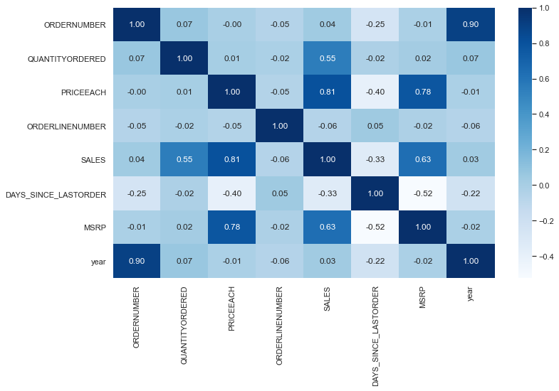
Bi variate Analysis

Slide 18
Eda SUMMARY [INFERENCES]
When we look at the monthly sales data we can see that November 2018 and November 2019 the sales have doubled comparing with other months data
Quarter wise data also shows sales spike every Q4 and 2019 shows highest sales followed by 2018 then 2020
Heatmap shows high correlation for Sales and MSRP, Sales and price of each item, Sales and Quantity hence these are the key driving factors
Most customers are from USA, Spain or France
Classic cars and vintage cars customers contribute most to sales when we look at the product line
Customers from Madrid, San Rafael and NYC cities contribute to sales highly
Euro shopping channel and Mini gift distributors are top customers who transact often

Slide 19
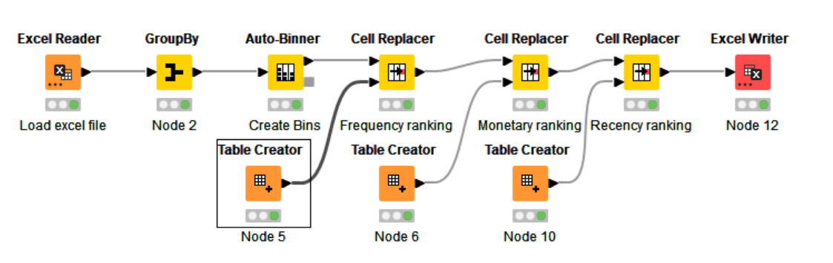
RFM Analysis (KNIME)

Slide 20
 |  |  | monetary
recency | frequency | 1 | 2 | 3 | 4
 | 1 | 11 | 0 | 0 | 0
1 | 2 | 1 | 4 | 0 | 0
 | 3 | 0 | 2 | 3 | 0
 | 4 | 0 | 0 | 1 | 1
 | 1 | 2 | 0 | 0 | 0
2 | 2 | 1 | 5 | 0 | 0
 | 3 | 0 | 3 | 5 | 1
 | 4 | 0 | 0 | 2 | 3
 | 1 | 5 | 2 | 0 | 0
3 | 2 | 0 | 2 | 0 | 0
 | 3 | 0 | 1 | 3 | 0
 | 4 | 0 | 0 | 2 | 7
 | 1 | 2 | 0 | 0 | 0
4 | 2 | 0 | 1 | 1 | 0
 | 3 | 0 | 2 | 4 | 1
 | 4 | 0 | 0 | 1 | 10

Slide 21
RFM Analysis Segments
Champions
Loyal
At Risk
Inactive

Slide 22
High value
We have identified 23 unique customers belonging to this segment
moderate
We have identified 22 unique customers belonging to this segment
At risk
We have identified 22 unique customers belonging to this segment
Champions
We have identified 23 unique customers belonging to this segment
Loyal
We have identified 22 unique customers belonging to this segment
At risk
We have identified 22 unique customers belonging to this segment
Inactive
Inactive
We have identified 22 unique customers belonging to this segment

Slide 23
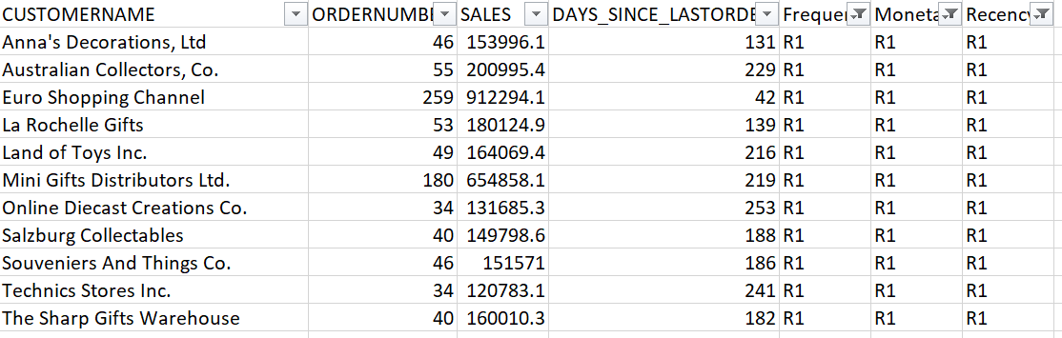
Who are your best customers?
Best customer belong to the Champion Segment
They have transacted recently in last 42 to 253 days
They have monetary value of 120783.1 to 912294.1
Their order frequency ranges from 34 to 259

Slide 24
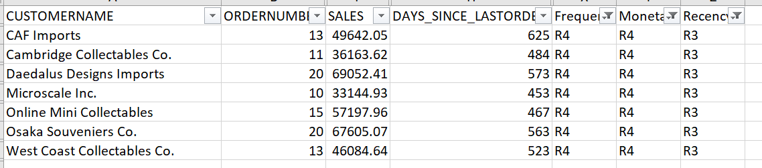
Which customers are on the verge of churning?
Customers who are on the verge of churning belong to the At Risk Segment
They have transacted recently in last 453 to 625 days
They have monetary value of 33144.93 to 69052.41
Their order frequency ranges from 10 to 20

Slide 25
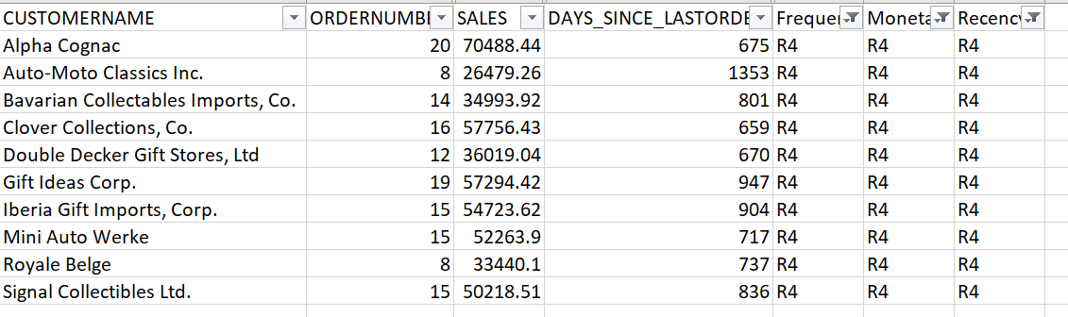
Who are your lost customers?
Customers who are lost belong to the Inactive Segment
They have transacted recently in last 659 to 1353 days
They have monetary value of 26479.26 to 70488.44
Their order frequency ranges from 8 to 20

Slide 26
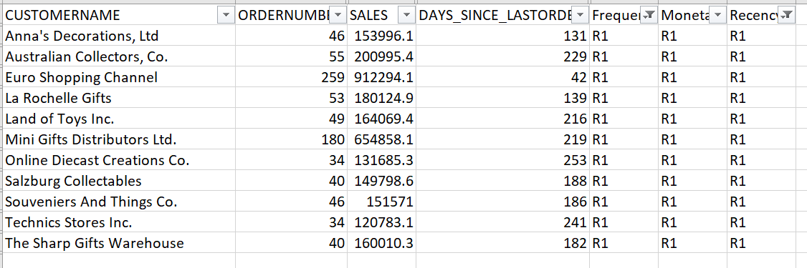
Who are your loyal customers?
Loyal customers belong to the Champion and Loyal Segment
They have transacted recently in last 42 to 253 days
They have monetary value of 120783.1 to 912294.1
Their order frequency ranges from 34 to 259

Slide 27
Inferences from RFM Analysis
After performing the RFM analysis we have identified 4 segments after grouping the customers by Customer name.
Out of the 89 customers, 23 customers belong to Champion segment, 22 customers belong to Loyal segment, 22 customers belong to At Risk Segment and 22 customers belong to Inactive segment.
RFM considers recency, frequency and monetary values for each customer. Combines them, and then groups them into different customer segments for easy recall and campaign targeting. RFM analysis is super useful in understanding responsiveness of your customers and for segmentation driven database marketing.
Now we can Target them for campaigns, Promote repeat purchase and loyalty, Defend against attrition/defection and Acquire customers who resemble the best ones.

Slide 28
Thank YOU

